Slide 1
Using SD Cards To Record Servo Motor Movements
https://www.youtube.com/watch?v=PQhQfww-qGQ
https://dronebotworkshop.com/sd-card-arduino/

Slide 2
Using SD Cards To Record Servo Motor Movements

Slide 3


HARDWARE & SOFTWARE requirements

Slide 4
Hardware Required
Arduino (Uno / Mega) x 2 pcs
Hookup cables
Usb cables x 2 for power and firmware download
LED x 1 (Example 2)
Potentiometer x 1 (Example 2)
SOFTWARE Required
Wire Library

Slide 5

PINOUT

Slide 6
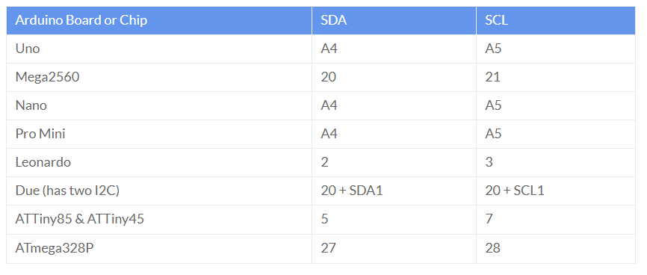
PINOUT

Slide 7
Hobby project(s)

Slide 8
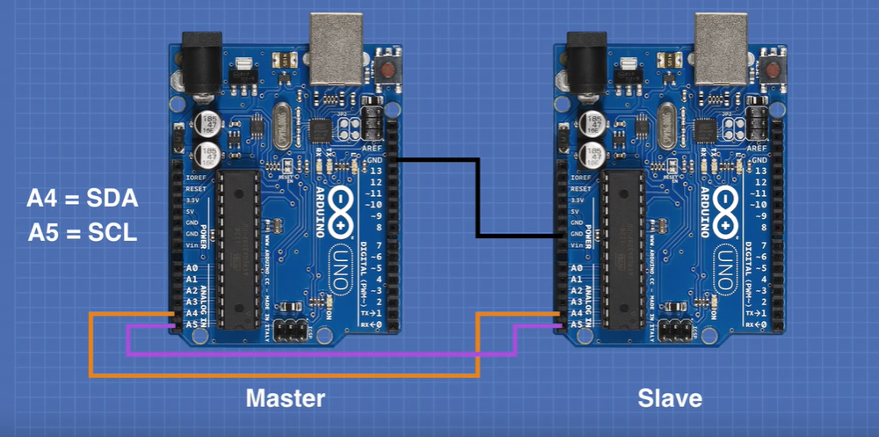
Circuit - 1

Slide 9
Actual PICS

Slide 10
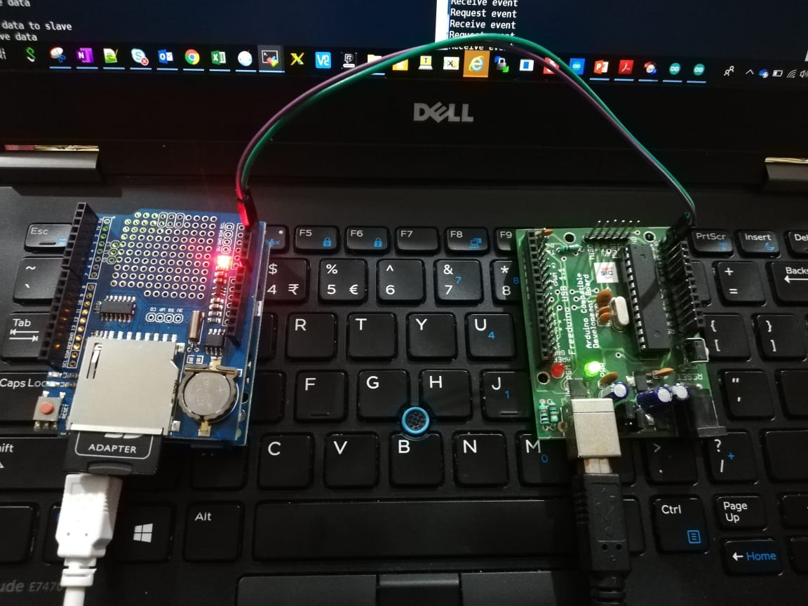
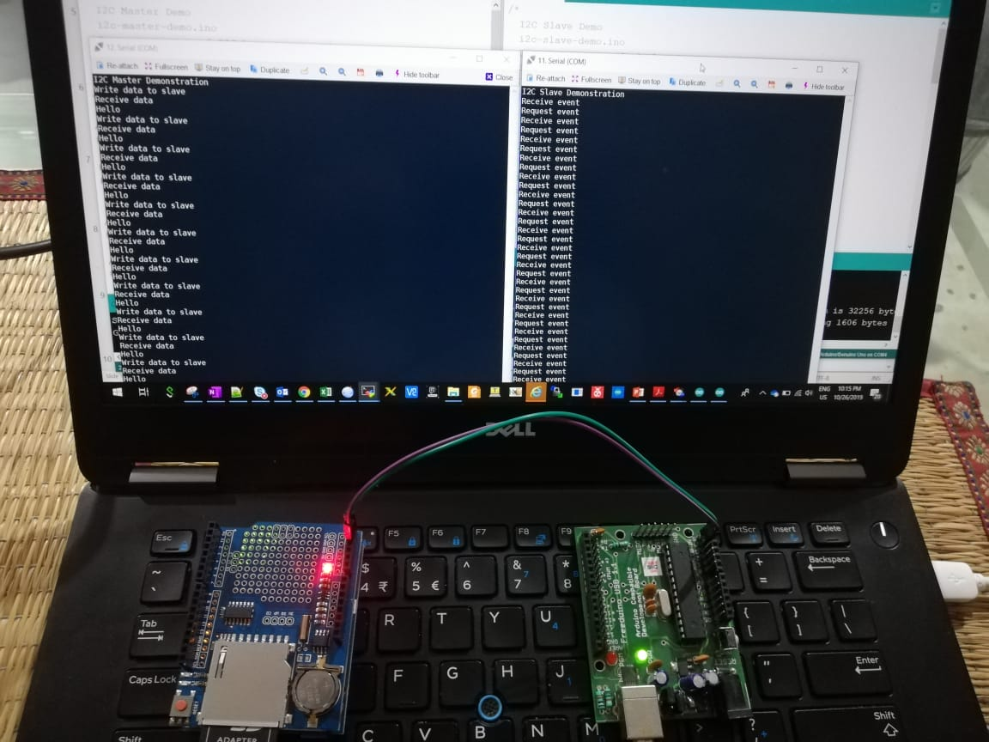
Actual PICS

Slide 11
Code – Example1
Arduino_Master
void loop() {
delay(LOOP_DELAY);
Serial.println("Write data to slave");
// Write a charater to the Slave
Wire.beginTransmission(SLAVE_ADDR);
Wire.write(0);
Wire.endTransmission();
Serial.println("Receive data");
// Read response from Slave
// Read back 5 characters
Wire.requestFrom(SLAVE_ADDR,ANSWERSIZE);
// Add characters to string
String response = "";
while (Wire.available()) {
char b = Wire.read();
response += b;
}
// Print to Serial Monitor
Serial.println(response);
}
// Include Arduino Wire library for I2C
#include <Wire.h>
#define SERIAL_BAUDRATE 115200
#define LOOP_DELAY 5000
// Define Slave I2C Address
#define SLAVE_ADDR 9
// Define Slave answer size
#define ANSWERSIZE 5
void setup() {
// Initialize I2C communications as Master
Wire.begin();
// Setup serial monitor
Serial.begin(SERIAL_BAUDRATE);
Serial.println("I2C Master Demonstration");
}

Slide 12
Code – Example1
Arduino_Slave
// Include Arduino Wire library for I2C
#include <Wire.h>
#define SERIAL_BAUDRATE 115200
#define LOOP_DELAY 5000
// Define Slave I2C Address
#define SLAVE_ADDR 9
// Define Slave answer size
#define ANSWERSIZE 5
// Define string with response to Master
String answer = "Hello";
void setup() {
// Initialize I2C communications as Slave
Wire.begin(SLAVE_ADDR);
// Function to run when data requested from master
Wire.onRequest(requestEvent);
// Function to run when data received from master
Wire.onReceive(receiveEvent);
// Setup Serial Monitor
Serial.begin(SERIAL_BAUDRATE);
Serial.println("I2C Slave Demonstration");
}
void receiveEvent() {
// Read while data received
while (0 < Wire.available()) {
byte x = Wire.read();
}
// Print to Serial Monitor
Serial.println("Receive event");
}
void requestEvent() {
// Setup byte variable in the correct size
byte response[ANSWERSIZE];
// Format answer as array
for (byte i=0;i<ANSWERSIZE;i++) {
response[i] = (byte)answer.charAt(i);
}
// Send response back to Master
Wire.write(response,sizeof(response));
// Print to Serial Monitor
Serial.println("Request event");
}
void loop() {
// Time delay in loop
delay(LOOP_DELAY);
}

Slide 13

Code – Explanation

Slide 14
Code – Explanation
For our first experiment we will hoo two Arduinos together and exchange data between them.
One Arduino will be the master, the other will be the slave. I’m using two Arduino Unos, but you can substitute other Arduino’s if you don’t have two Unos. Use the previous chart for the connections.
One thing to be aware of is that my diagram does not show the use of pull-up resistors, I found that everything seemed to work correctly without them. However, you might want to include them, especially if you experience errors or intermittent operation.
To hook up some pull-up resistors attache a couple of 10k resistors to the SDA and SCL lines. Attach the other end to the 5-volt output on one of the Arduino’s.
Master Arduino Code :
As with all I2C sketches, we start by including the Wire library.
Next we define a few constants to represent the I2C address of the slave and the number of bytes of data that we expect to retrieve from it.
In the Setup we initialize the I2C communications as a master. We know it is a master as there is no address parameter in the begin function. We also setup a serial monitor and print a line of text to it.
Now to the Loop.
We start with a tiny time delay, mostly to slow things down enough so that we can read the display on the serial monitor.
Next we use the beginTransmission function to send data to the slave. In this case the data we send is just a number zero. We finish sending with a call to the endTransmission function.
Next we request some data back from the slave using the requestFrom function.
After that we formulate a response string by reading the data, a byte at a time, from the slave.
We print the details of what we are doing and of the data we receive to the serial monitor. And then we finish the Loop and do it all over again.

Slide 15
Code – Explanation
Slave Arduino Code :
Once again we start by including the Wire library. As with the previous sketch we also define the I2C address for the slave, as well as the number of bytes we are planning to send back to the master.
Next we define the string that we are going to send back to the master, in this case just the word “Hello”. If you decide to change this make sure that you adjust the ANSWERSIZE constant in both sketches to be correct.
In the Setup we initialize the connection to the I2C bus with a begin function. Take note of the different way we do this, as this is a slave we specify the I2C address we are going to be using. By doing this the Wire library knows we want to operate in slave mode.
Now we need to define the names of the functions that we will call when two events occur – a data request received from the master and data received from the master. We also setup and print to the serial monitor.
The function receiveEvent is called when we receive data from the master. In this function we read data while the data is available and assign it to a byte (remember, the data will be received one byte at a time).
The requestEvent function is called whenever we get a request for data from the master. We need to send our string “Hello” back to the master. As we need to send the data one byte at a time we divide the characters in “Hello” into individual items in an array and then send them one-by-one.
We report all of our progress in both functions to the serial monitor.
The Loop in this sketch just adds a time delay, which matches the one used in the master sketch.

Slide 16
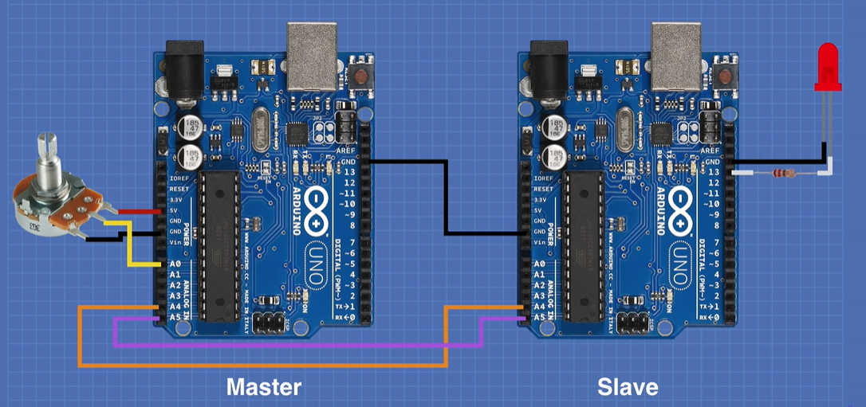
Circuit - 2

Slide 17
Actual PICS

Slide 18
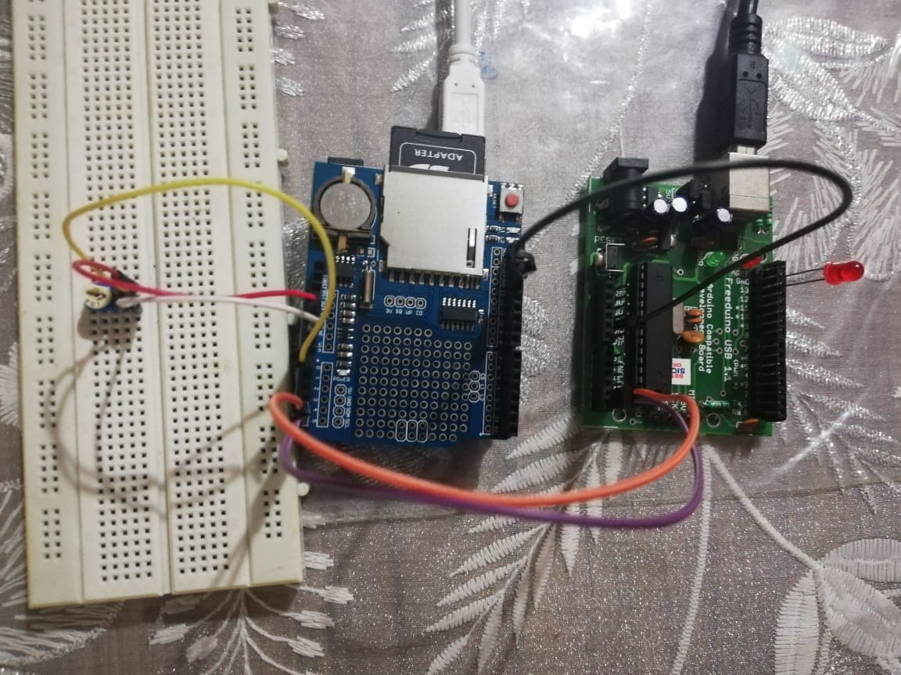
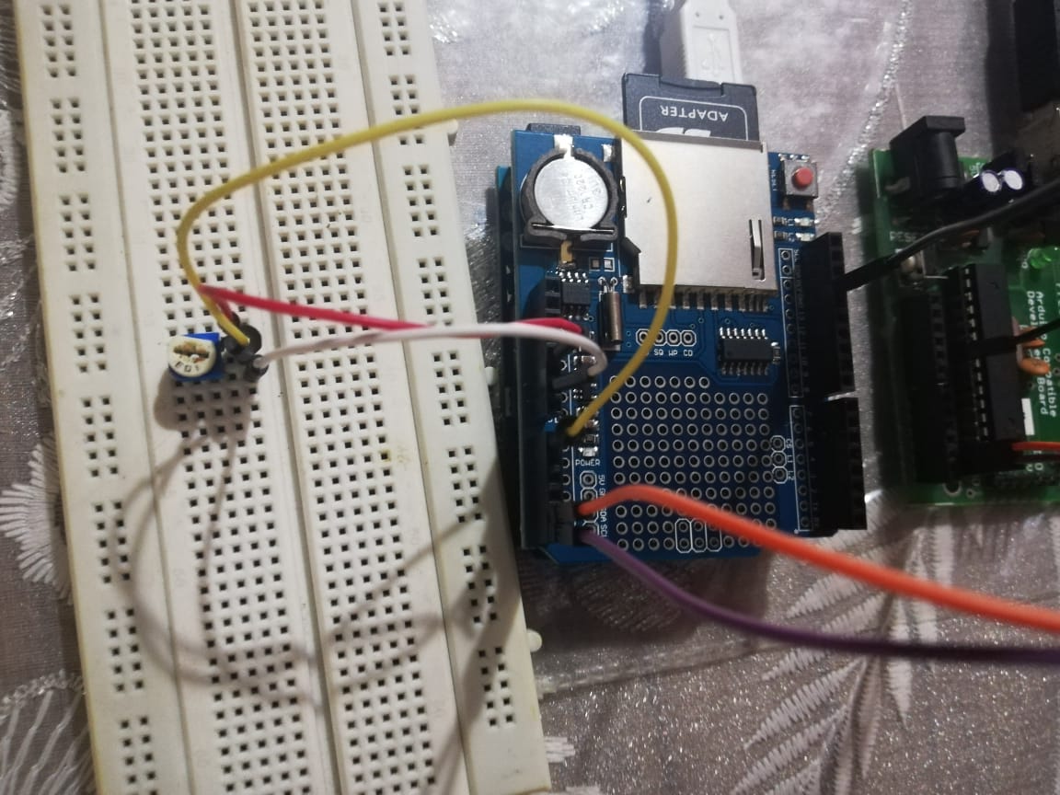
Actual PICS

Slide 19
Code – Example2
Arduino_Master
// Include Arduino Wire library for I2C
#include <Wire.h>
// Define Slave I2C Address
#define SLAVE_ADDR 9
// Analog pin for potentiometer
int analogPin = 0;
// Integer to hold potentiometer value
int val = 0;
void setup() {
// Initialize I2C communications as Master
Wire.begin();
}
void loop() {
delay(50);
// Read pot value
// Map to range of 1-255 for flash rate
val = map(analogRead(analogPin), 0, 1023, 255, 1);
// Write a charatre to the Slave
Wire.beginTransmission(SLAVE_ADDR);
Wire.write(val);
Wire.endTransmission();
}

Slide 20
Code – Example2
Arduino_Slave
// Include Arduino Wire library for I2C
#include <Wire.h>
// Define Slave I2C Address
#define SLAVE_ADDR 9
// Define LED Pin
int LED = 13;
// Variable for received data
int rd;
// Variable for blink rate
int br;
void setup() {
pinMode(LED, OUTPUT);
// Initialize I2C communications as Slave
Wire.begin(SLAVE_ADDR);
// Function to run when data received from master
Wire.onReceive(receiveEvent);
// Setup Serial Monitor
Serial.begin(9600);
Serial.println("I2C Slave Demonstration");
}
void receiveEvent() {
// read one character from the I2C
rd = Wire.read();
// Print value of incoming data
Serial.println(rd);
}
void loop() {
delay(50);
// Calculate blink value
br = map(rd, 1, 255, 100, 2000);
digitalWrite(LED, HIGH);
delay(br);
digitalWrite(LED, LOW);
delay(br);
}

Slide 21
Code – Explaination

Slide 22
Code – Explanation
In the next demonstration we will hook a potentiometer to the master Arduino and an LED to the slave. We will use the potentiometer to control the blink rate of the LED.
It is essentially the same hookup as the previous experiment, with the addition of the potentiometer on the master and the LED on the slave.
Note that the LED on the slave has been attached to pin 13. As the Arduino Uno has a built-in LED on pin 13 you may eliminate the LED and its dropping resistor if you wish.
The remarks about pull-up resistors also apply to this hookup.
The sketch for the master side of this experiment is very simple, in some ways the I2C side is even simpler than the one used in the first demonstration. This is because we are just sending data to the slave and are not expecting to get any back.
Master Arduino Code :
As with all I2C sketches, we start by including the Wire library.
As always we need to include the Wire library at the beginning of the sketch. We also will define a constant to hold the slave address.
Since we are using a potentiometer we will need to define both the pin it is connected to and a variable to hold its value.
All that we do in the Setup is to initialize the I2C connection as a master.
In the Loop we read the potentiometer value and map it to a range of 01-255. We need to do that as we are sending one byte of information and can only hold this many values in a single byte.
Note that we reverse the numbering sequence in the Arduino Map function, this is done so that the system behaves the way we expect it to – turning the potentiometer to the right increases the flash rate. As the “flash rate” is specified by a time delay a bigger number being sent will equate to a longer flash rate.
Also note that we don’t send the value 0, which would just hold the LED at one state. We set our range to end at 1 instead.
Now it’s just a matter of sending the byte to the slave and repeating the Loop again.

Slide 23
Code – Explanation
The slave side needs to receive data from the master and use it to flash the LED.
Slave Arduino Code :
We start with the usual inclusion of the Wire library, as well as defining the slave address. We also define a pin for the LED.
A couple of additional variables are defined, one holding the received data while the other carries the time delay value for the blink rate.
In the Setup we set the I/O pin for the LED as an output and initialize the I2C bus. As we use the slave address in the begin function the Wire library knows we are acting as a slave.
We only need to define an onReceive function, unlike the last demo we are not expecting any requests from the master. We also set up and print to the Serial monitor, we will use the monitor to view the incoming data.
The receiveEvent function reads the incoming data and assigns it to the I variable. It also prints the value to the serial monitor.
Finally, in the Loop we use the incoming data to blink the LED. Once again we use the Map function to accomplish this, changing the incoming values of 1-255 to a wider range. You can experiment with changing this range to make the LED blink faster or slower if you wish.
The last few statements are essentially the Arduino Blink sketch in disguise! We turn the LED on and off for a time period we determined in the last step.
And then we repeat the loop.

Slide 24
TROUBLESHOOT guide

Slide 25
TROUBLESHOOT guide
1. Even after connecting I2C SDA and SCL lines on Arduino, the communication doesn’t seem to happen.
What can I do to improve this??
Try adding a Pull up resistor (External Pull up).
In case of Arduino Uno , we may need to add external pull up resistors on A4 & A5 pins.
However, in case of Arduino Mega (pin 20 & 21 have internal pull-up resistors already present.
Check if the Slave Address is properly calculated and passed.

Slide 26
Sketch file
Example 1
( Send / Receive Data over I2c )
Example 2
( Control LED Blinking via Potentiometer over I2C )

